Slide 1
Married
to the Mob
(programming)
Notes:
Welcome to this session on MP
Thank you for being here.

Slide 2
hey hi hello
derek graham @deejaygraham
Notes:
My name, twitter handle.
This is a big topic so I’ll try to cover as much as possible.
If you want to talk after. I am around all day - grab me to chat.

Slide 3

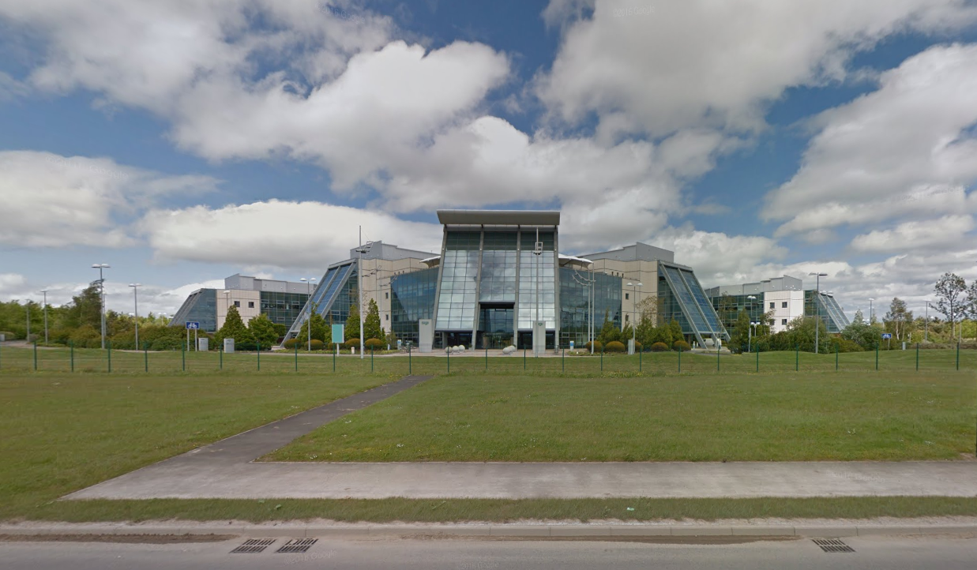

Notes:
Principal Dev at Sage in Newcastle
Sage is one of the sponsors for today and we are usually hiring, so come and talk to me later.

Slide 4
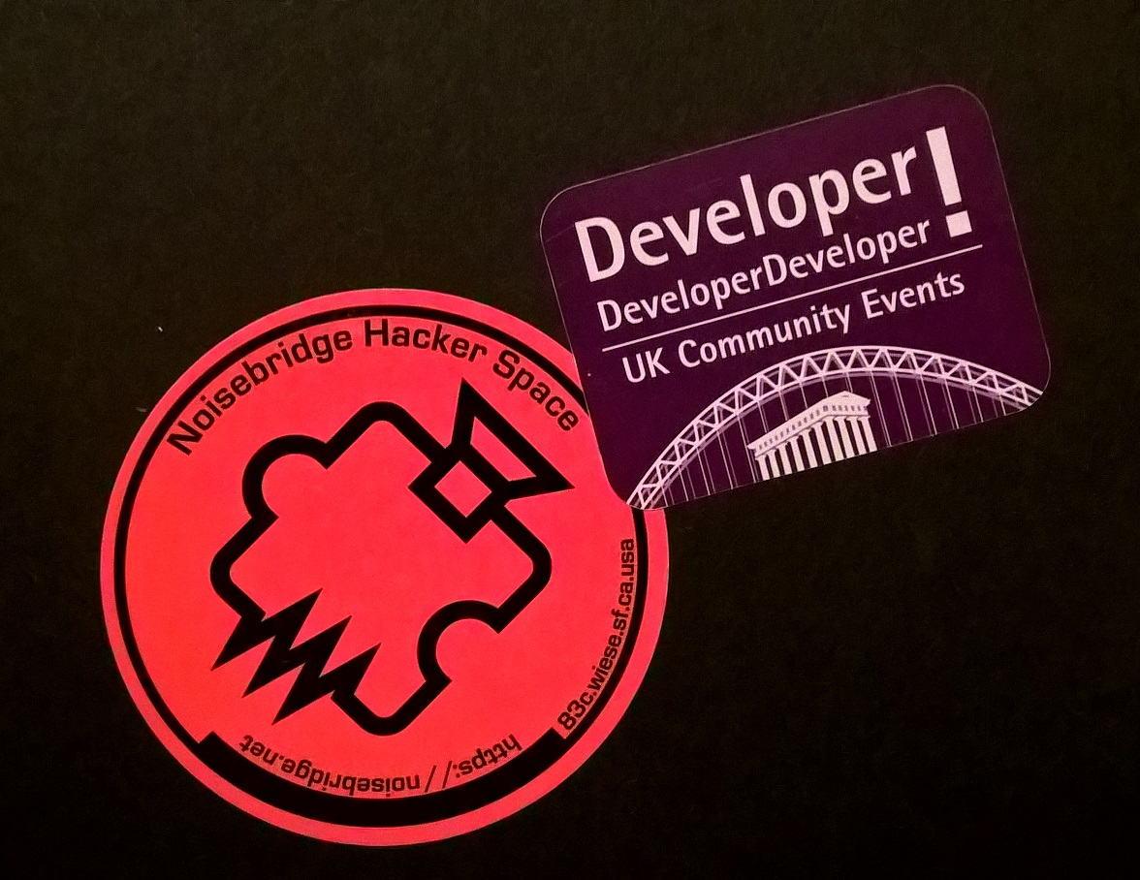
Notes:
Co Org of two developer meetups in Newcastle Agile North East and NE Bytes
Running dev meetups and coding dojos at work where we can be programming as a group larger than a pair lead me to evolve a similar approach to MP which meant I recognized the possibilities when I became aware of it about 3 years ago.

Slide 5
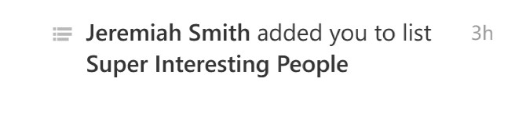
Notes:
Also I am super interesting…
if you believe twitter and I don’t have the courage to go and look at that list.

Slide 6
The characters and events
depicted in this
presentation are fictitious.
Any similarity to actual persons, living or dead, is purely coincidental
Notes:
A disclaimer before we go any further. Wanted to show actual team photos but Newcastle folk are very shy, they don’t go out much.
Couldn’t get anyone to pose - some scenes
are reconstructed for narrative purposes.

Slide 7
Mob?
Notes:
Today I want to talk about how we organize ourselves to write and deliver software.
MP is a technique I try to use all the time now and if not fall back to using strong style pairing. I have used it at work, in coding dojos and even teaching kids to program.
Let’s talk about the road to mobbing

Slide 8

Notes:
Way back in history, the default delivery stratgey was Awesome Ninja Rockstar Pirates Developers.
Individual contributors largely with their own specialisation and implied silos.
Long feedback cycles and large batches of work. Bugs take a while to emerge and the developer has moved their focus, need to come back for rework.

Slide 9
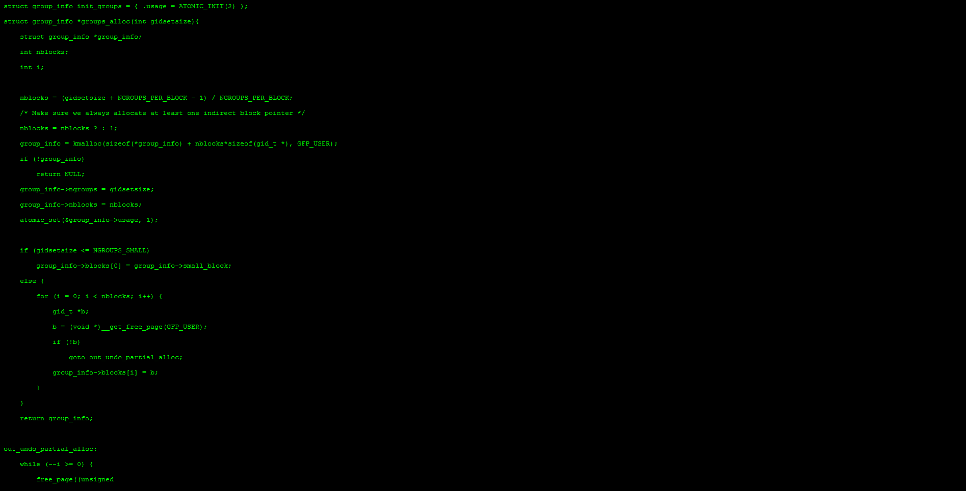
Notes:
Turn Coffee and an Awesome Idea into green on black code.
More code == better
And we’ll take all the code from everyone on the project and jam it all together at the end and ship it

Slide 10
90% done
Notes:
Classic project management problem. Developer reports 90% done, only last 90% remaining.

Slide 11
PROCESS
Notes:
To combat this, we attacked the poor dev with more process, code reviews, status meetings - when will you be done?
In late 1990s, early 2000s Kent Beck made up a new thing - XP

Slide 12
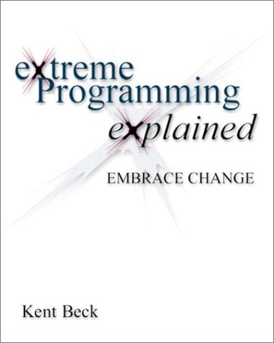

Slide 13
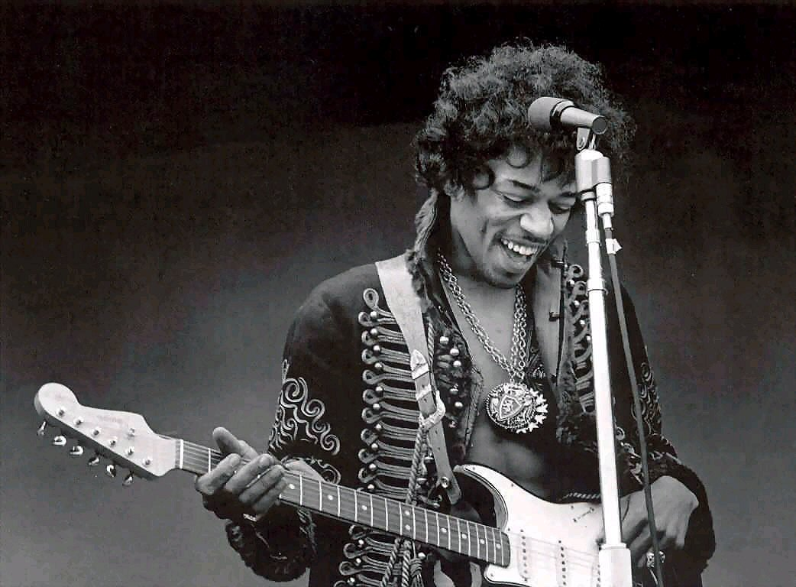
are you
XP?
Notes:
Ask Audience Agile - who is practicing xp
Regularly pairing?

Slide 14
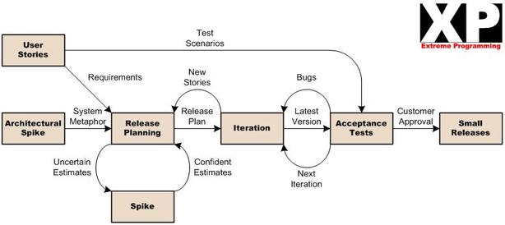

Slide 15
XP Engineering Practices
Continuous Integration
Pair Programming
Test Driven Development
Simple Design
Refactoring
Collective Code Ownership
Sustainable Pace
Notes:
Pair Prog, TDD, CI builds all Aimed at working in smaller batches, getting faster feedback.
Pair works on a problem and maybe pairs switch around to spread knowledge.
Still requires Standups, Meetings.
Another approach is one we stumbled on a couple of years ago…

Slide 16
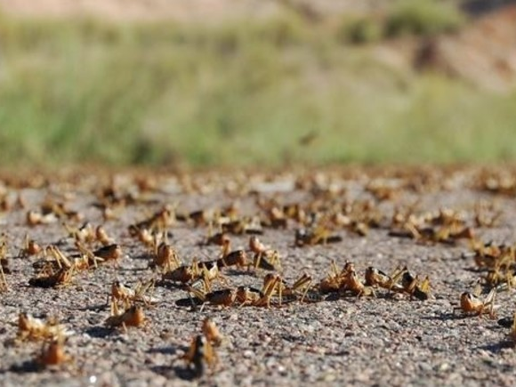
Swarming
Notes:
In pairs, two people work on one thing and another pair will usually work on something different. Swarms - all the team work on one problem at the same time.

Slide 17

Notes:
Given an puzzle. Each team member owns piece of the puzzle and split to work on it individually or in pairs but come together regularly to integrate and test.

Slide 18
C#
Test Script
DB Admin
JSON
HTML
Deploy Script
Notes:
Less specific to traditional roles - someone could be writing a test, someone writing a piece of front end, someone writing backend, database, deployment. All in service of one problem. Fix that problem and move on to next.

Slide 19
“Swarming … is the first time we’ve felt like a genuine team instead of individuals all working for the same manager.”
– Our Team
Notes:
love this quote from a retrospective…
Felt much more like a sports team - helping each other out.

Slide 20
Begin {
Notes:
Mobbing began by accident…

Slide 21
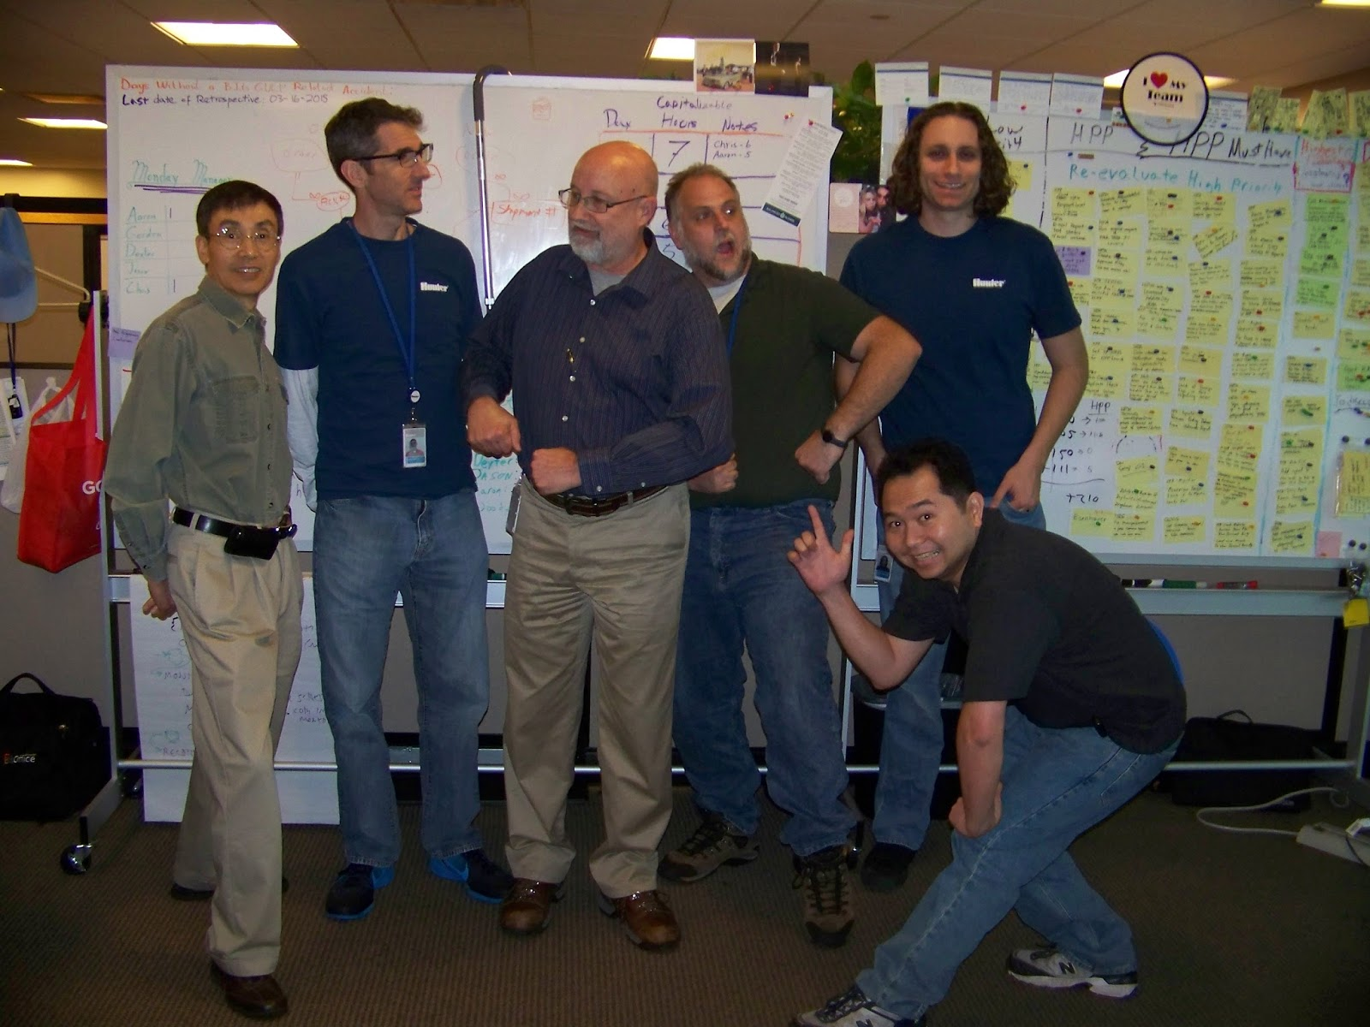
Notes:
Hunter - quality and shipping
Deliberate Practice - Learning Hour - safe space.
Experimenting with writing tests, patterns, katas
Went back to individual working at end of hour.
Found they preferred working as a group
Decided to experiment
Named it Mob as next highest collective noun for devs Pairing -> Swarming -> Mob

Slide 22
“All the brilliant people, working on the same thing,
at the same time,
in the same space,
and at the same computer.”
–Woody Zuill
Notes:
He says it best…
And when we say all we mean devs, testers, Bus analysts, customers, ops.
Everyone who is interested and feels they can contribute.

Slide 23
Mob != Code
Notes:
This isn’t about just writing code, all dev activities, it’s design, analysis, coding, testing. Little bits of everything done in tiny iterations.
Strength is that many facets of software are distributed in the mob - each person from their own discipline, someone is thinking about syntax, efficiency, unit testing, automation, security, bizarre test scenarios…

Slide 24
Mob = XP++
Notes:
I like to think about MP as the next step up from xp.

Slide 25
“ Mobbing would be in the XP book
(if they'd thought of it)”
–Rachel Davies (Agile Coach)
Notes:
Rachel Davies Agile Coach says…

Slide 26
Mob !=
Notes:
Quickly point out - it’s not a chance for someone to program with an audience.

Slide 27

!Mob
Notes:
Quickly point out - it’s not a chance for someone to program with an audience. Getting back to rockstar territory. Showing off what you know, about true collaboration and sharing.

Slide 28
Notes:
it’s not a chance to program with an audience - showing off how much you know.

Slide 29
hello, Mob
Notes:
Some simple things to get started and write our equivalent first hello world…

Slide 30
One set of Input Devices (keyboard and mouse)
Everyone can see the code
Everyone has a role
Roles rotate over time
Notes:
Fundamentals are…

Slide 31
Large Screen or HD Projector
Keyboard & Mouse
Timer
Whiteboard
A Problem
Notes:
To get started, you will need…
Timer to make sure we rotate roles regularly.
Whiteboard to make notes for stuff to pursue later.
Problem or what’s the point?
Mob size will determine size of workspace. Usually 3-6 people.Also implies comfortable seating

Slide 32
4-6 people
comfortable space
let everyone speak
take time to discuss
2-3 times per week
1-2 hours each

Slide 33

* reconstruction
Notes:
team gathered around a single computer.
awesomeness (not actual team) for dramatic reconstruction.

Slide 34
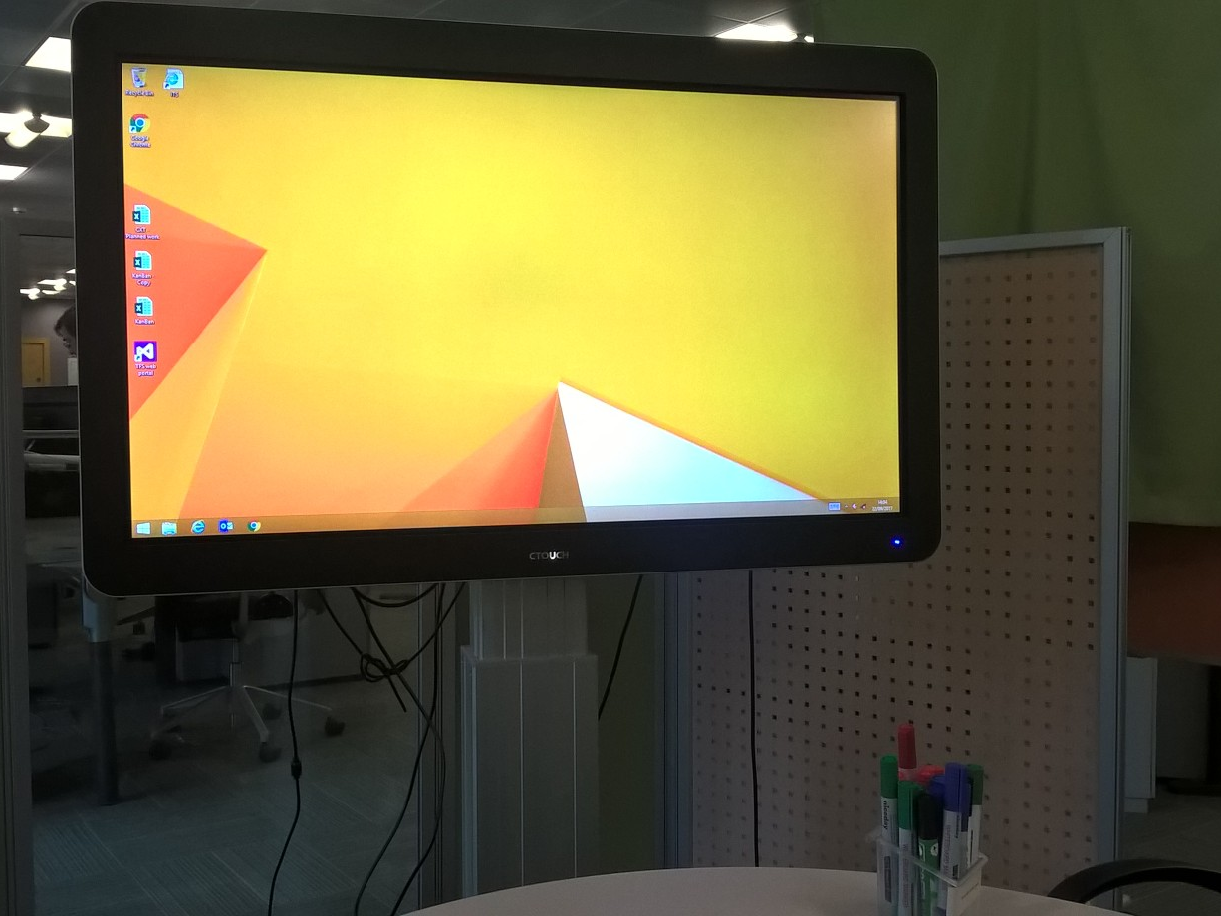
Notes:
Big TVs
RDP,
Local laptop
Seats arranged around desk in closed off area.

Slide 35
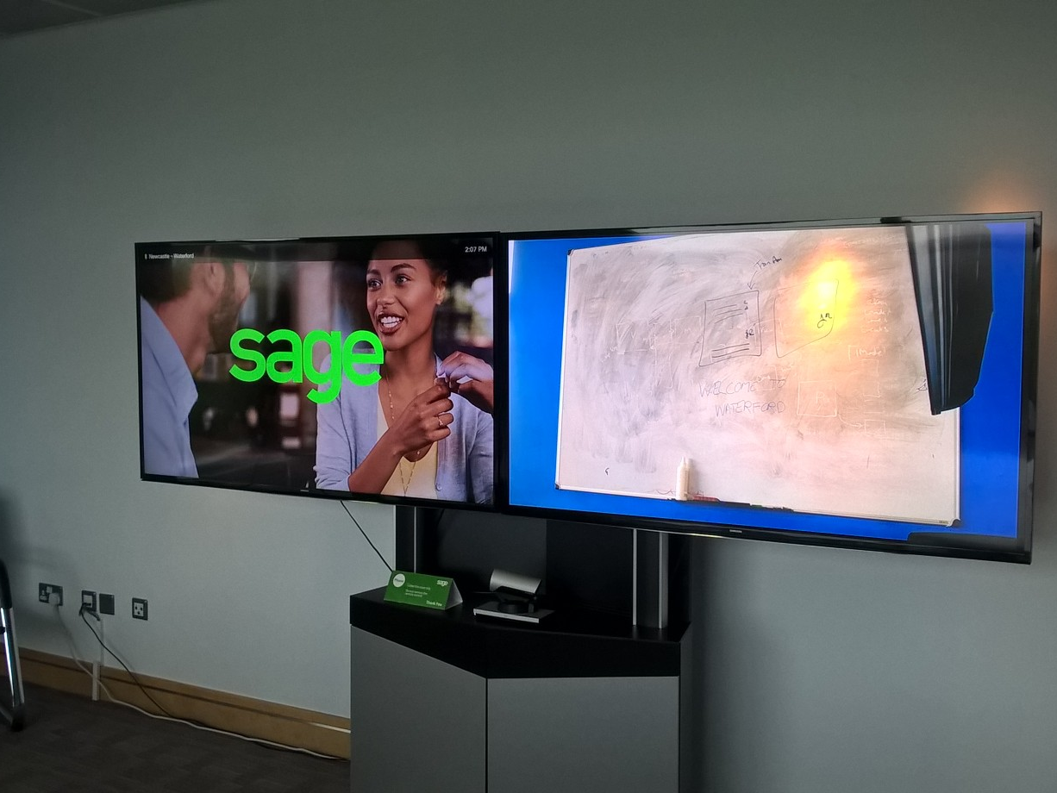
Notes:
remote mobbing, teleconference - big screen - one for code, one for whiteboard so that remote can see what we see.

Slide 36
Notes:
Other computers are allowed
admin,
dev ops,
deployment,
testing,
email,
research

Slide 37
#Waste
Notes:
Before we go on, I want to just address the “why am I paying 5 people to do the job of one” argument. MP vastly reduces the number of meetings, and handoffs you need, standups, code reviews, waiting around for someone’s opinion, feedback from testers

Slide 38
Mob Roles
Notes:
MP has only two roles - profession agnostic - but they are a bit different from what you would expect.

Slide 39
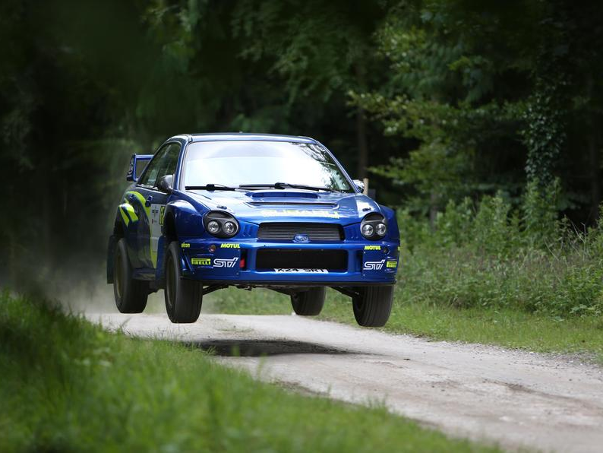
Notes:
Rallying - is a two person sport.
Driver - short range focus - pedals, gears, steering
Navigator - Longer range - hills and bends
Each specializes, don’t swap.
XP borrows this.

Slide 40
Navigator
Driver
Notes:
In XP, there are two people sitting at a single computer and sharing a keyboard. One driver and one navigator.
Swap as required and roles reverse.

Slide 41
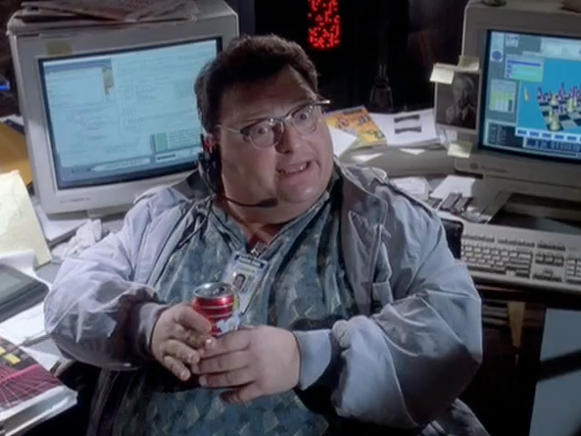
Driver
* reconstruction
Notes:
The driver is the person with an idea of how to solve the problem and types and hopefully narrates.
Thinking about making current code compile. focussed on syntax etc.

Slide 42

* reconstruction
Navigator
Notes:
The Navigator (a small boy) sitting next to him thinking about next test, higher level of abstraction.

Slide 43
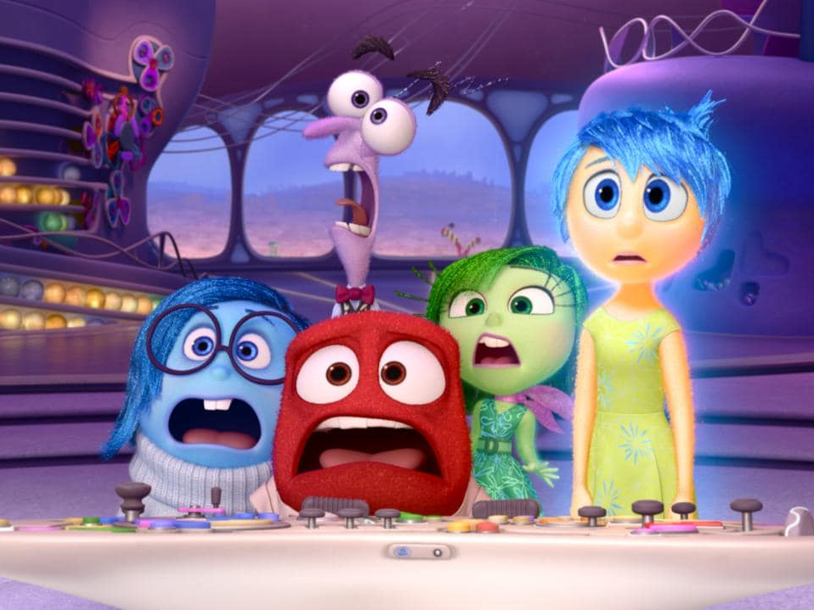
* reconstruction
Notes:
MP turns this idea inside out.
Single driver is writing code but the direction comes from the (multiple) Navigators.

Slide 44
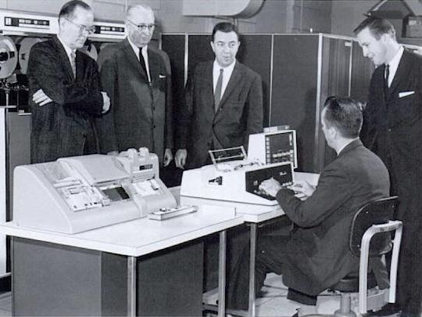
* reconstruction
Notes:
Here’s what that looks like.
Single input device, code is here, here, here…
Driver sits at keyboard, navigators arranged around.

Slide 45
Facilitator?
Navigator
Navigator
Navigator
Driver
* reconstruction
Notes:
Driver
Navigators
Facilitators? - New and Large groups.

Slide 46
Mob Rules
Notes:
There are some rules to make Mobbing work smoothly

Slide 47
Kindness
Consideration
Respect
“Yes and…” ideas
Strong-style Pairing
Notes:
Spending a lot of time together and it’s easy for resentment and anger to build up and cause unhappiness
name calling, fundamental attribution error - i broke the build, you broke the build.
Yes and improv, don’t kill someone’s idea

Slide 48

Notes:
if you feel like you have to be a saint like Mr Rogers to be kind, considerate, respectful…

Slide 49
“We decided for one day to pretend to be kind, considerate and respectful. And then we decided to do it again.”
– Woody Zuill
Notes:
Pretend, maintain that pretence for a short time.
Over time, that becomes reality.
Something else to adopt this mindset
ASK Anyone doing retrospectives in their process?
Norm Kerth wrote the book

Slide 50
“Regardless of what we discover, we understand and truly believe that everyone did the best job they could, given what they knew at the time, their skills and abilities, the resources available, and the situation at hand.”
–Norm Kerth
Notes:
Mantra we use in our retros to set the right frame of mind. Norm Kerth’s retro prime directive.

Slide 51
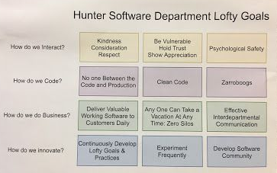
Notes:
Hunter went on to create a set of Lofty Goals with KCR at top left.

Slide 52
if you aren’t learning or contributing, find a better use for your time.
Notes:
No coercion.

Slide 53
Mob Roles, 2
Notes:
Let’s talk a bit more about the roles in Mobbing.

Slide 54
Driver
Notes:
I think Driver (from XP) is too active - in MP the driver is a more passive role

Slide 55
Driver Typist
Notes:
so I am coming round to using typist.
After all they take input from surroundings and do something with that request. If you don’t like typist how about…

Slide 56
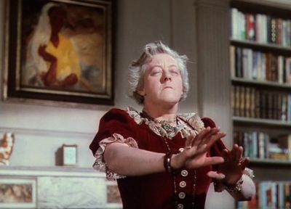
Notes:
communing with the spirit of the mob to divine what the next piece of code is.
Like Madame Arcarty from Blythe Spirit.
If you are more technically minded…

Slide 57
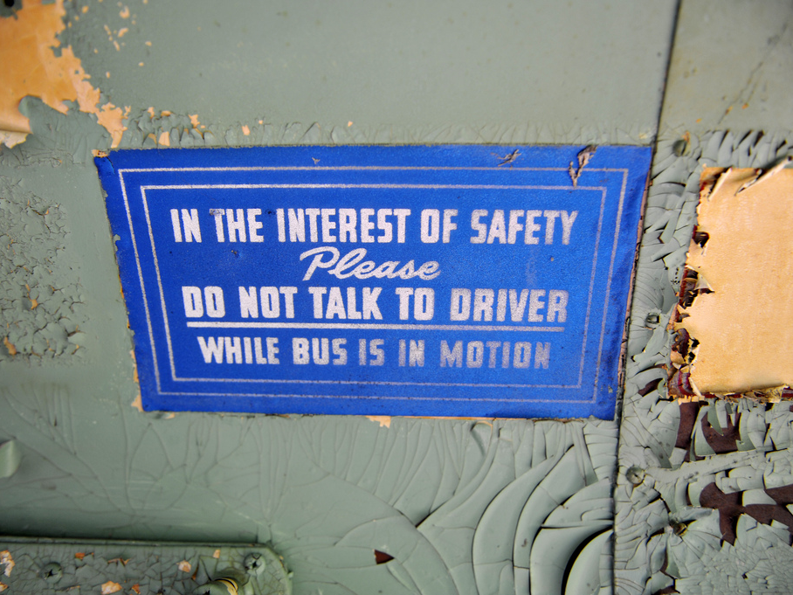

Slide 58

Cortana for Code
Listen to the mob
Translate that into code
There is no 3
Notes:
Let’s call it

Slide 59

Siri for Syntax
Write the Code
Talk about the Code
Rollback?
Patience
Incomplete Understanding
Notes:
Sit with incomplete unfinished stuff. Difficult thing to do for someone who wants code to compile.

Slide 60

Alexa for Algorithms
Notes:
Ok, I’m going to stop there.
Important thing to remember is…

Slide 61
If you have
the keyboard,
you can’t have
the ideas

Slide 62
Mob % Typist
Notes:
The remainder of the mob … are navigators

Slide 63
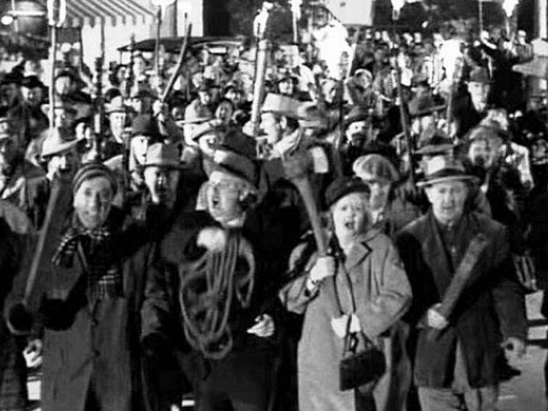

Slide 64
Collaborate & Discuss
What is the next step?
Talk to the Typist
Park other issues
Notes:
Discussion
Agree next step
Give clear instruction to the typist - may need a nominated person
Whiteboard

Slide 65
The team is like an extended brain,
it needs to talk out loud to know what it thinks
Notes:
There’s lots of talking and it can get quite loud but it is important to do it. We’ll come back to this in a bit.

Slide 66
Mob Rotation

Slide 67

Typist
Navigator
Navigator
Notes:
Just like in pairing, roles swap around in the team.
Person types for a little while, then they become a navigator and someone who was a navigator becomes a new typist. Everyone rotates through the typing seat. No second goes.

Slide 68
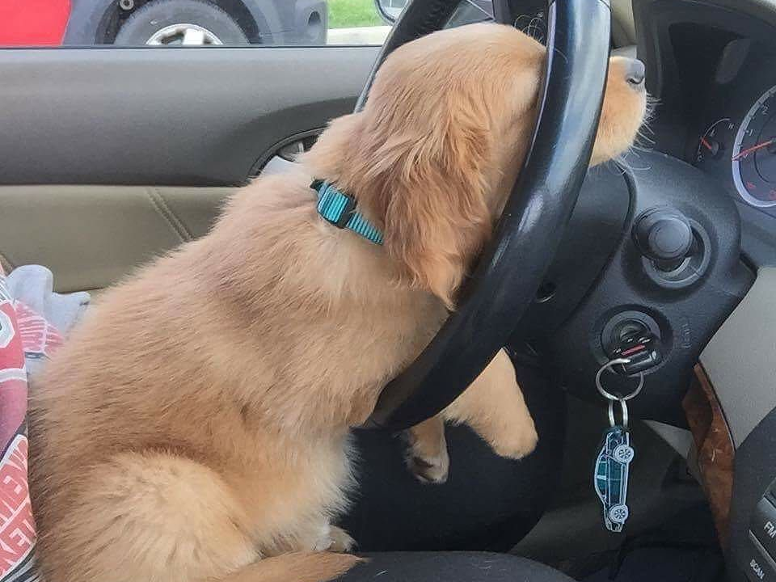
* reconstruction
Notes:
Doing anything for a time can be tiring.
Can be done organically - finish a thought before changing
But monitor to make sure nobody is hogging one role.
Also note that you are free to get up, stretch, walk have a cuppa, and the mob continues on. Can’t do that while pairing.

Slide 69
Facilitator?
Navigator
Navigator
Navigator
Typist
Timer
* reconstruction
Notes:
Enclosed area? Can use a mechanical egg timer
Use phone or use a mob timer - browser

Slide 70
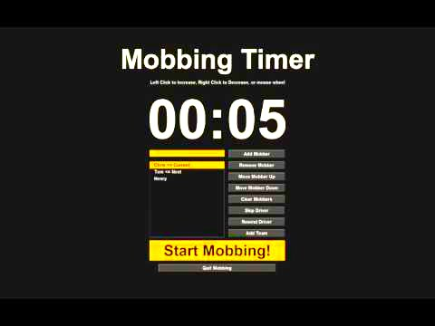
Notes:
here’s an example

Slide 71
Strategies
Notes:
line numbers
10.5
variable naming
white board/pad

Slide 72
Strong Style
Pairing
Notes:
Thing everyone notices about MP is the number of people you have gathered in one space. But there’s a technique at the core of MP that not many people talk about.

Slide 73

<strong>
</strong>
Notes:
Obligatory fruit joke.
this technique is the game changer
use on monday morning
what i use at work as much as I can

Slide 74
Have you ever had a bug?
Notes:
how did you fix it?
Don’t have to tell me now.
What about if you didn’t know what the problem was?

Slide 75
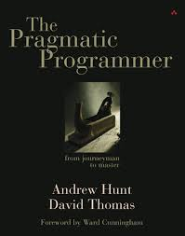
Notes:
2000 ish
lots of good tips
get it and read it if you haven’t already.

Slide 76
Notes:
One technique was rubber ducking.
Who has had this experience - sometimes you get stuck on a problem and you can’t find a solution. You describe the problem to someone else and the answer hits you before you finish your thought.
That’s RD. It doesn’t have to be a person it can be a duck or a stress ball. Speaking aloud and listening to yourself seem to be the key.
I have been doing this since I read about it.
SF Cory Doctorow corpus collossum - what it was but not what it was called. Speaking out loud.

Slide 77
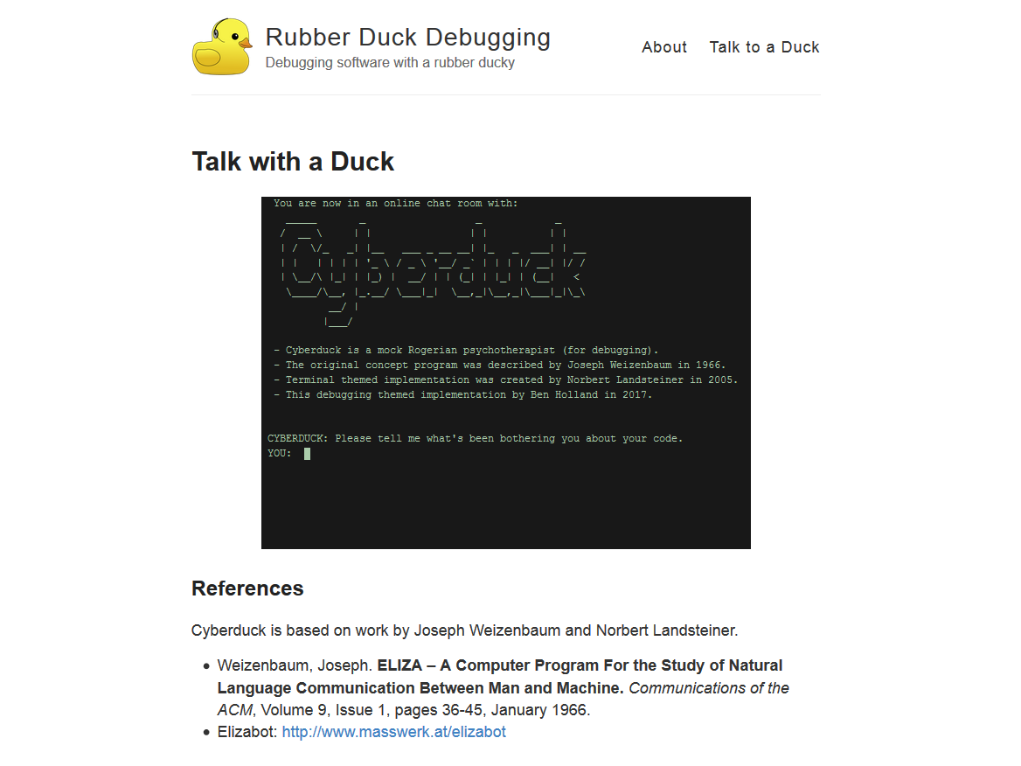
Notes:
Eliza bot repackaged as a code analysis tool

Slide 78
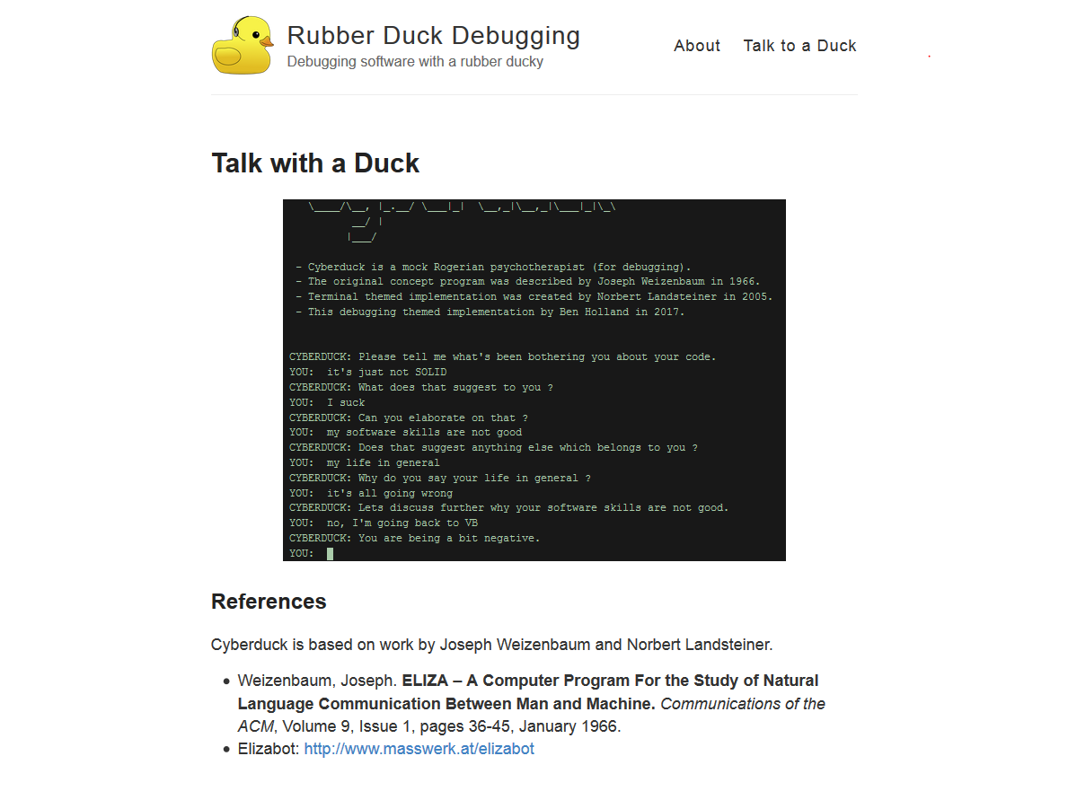
Notes:
Doesn’t work as well. Speaking and listening back is the thing that works.

Slide 79

Notes:
One of the people working at Hunter with Woody
formalized this verbalisation into SSP
And it is something you can do as when pairing, it’s just used more in MP context when interacting with a typist.

Slide 80
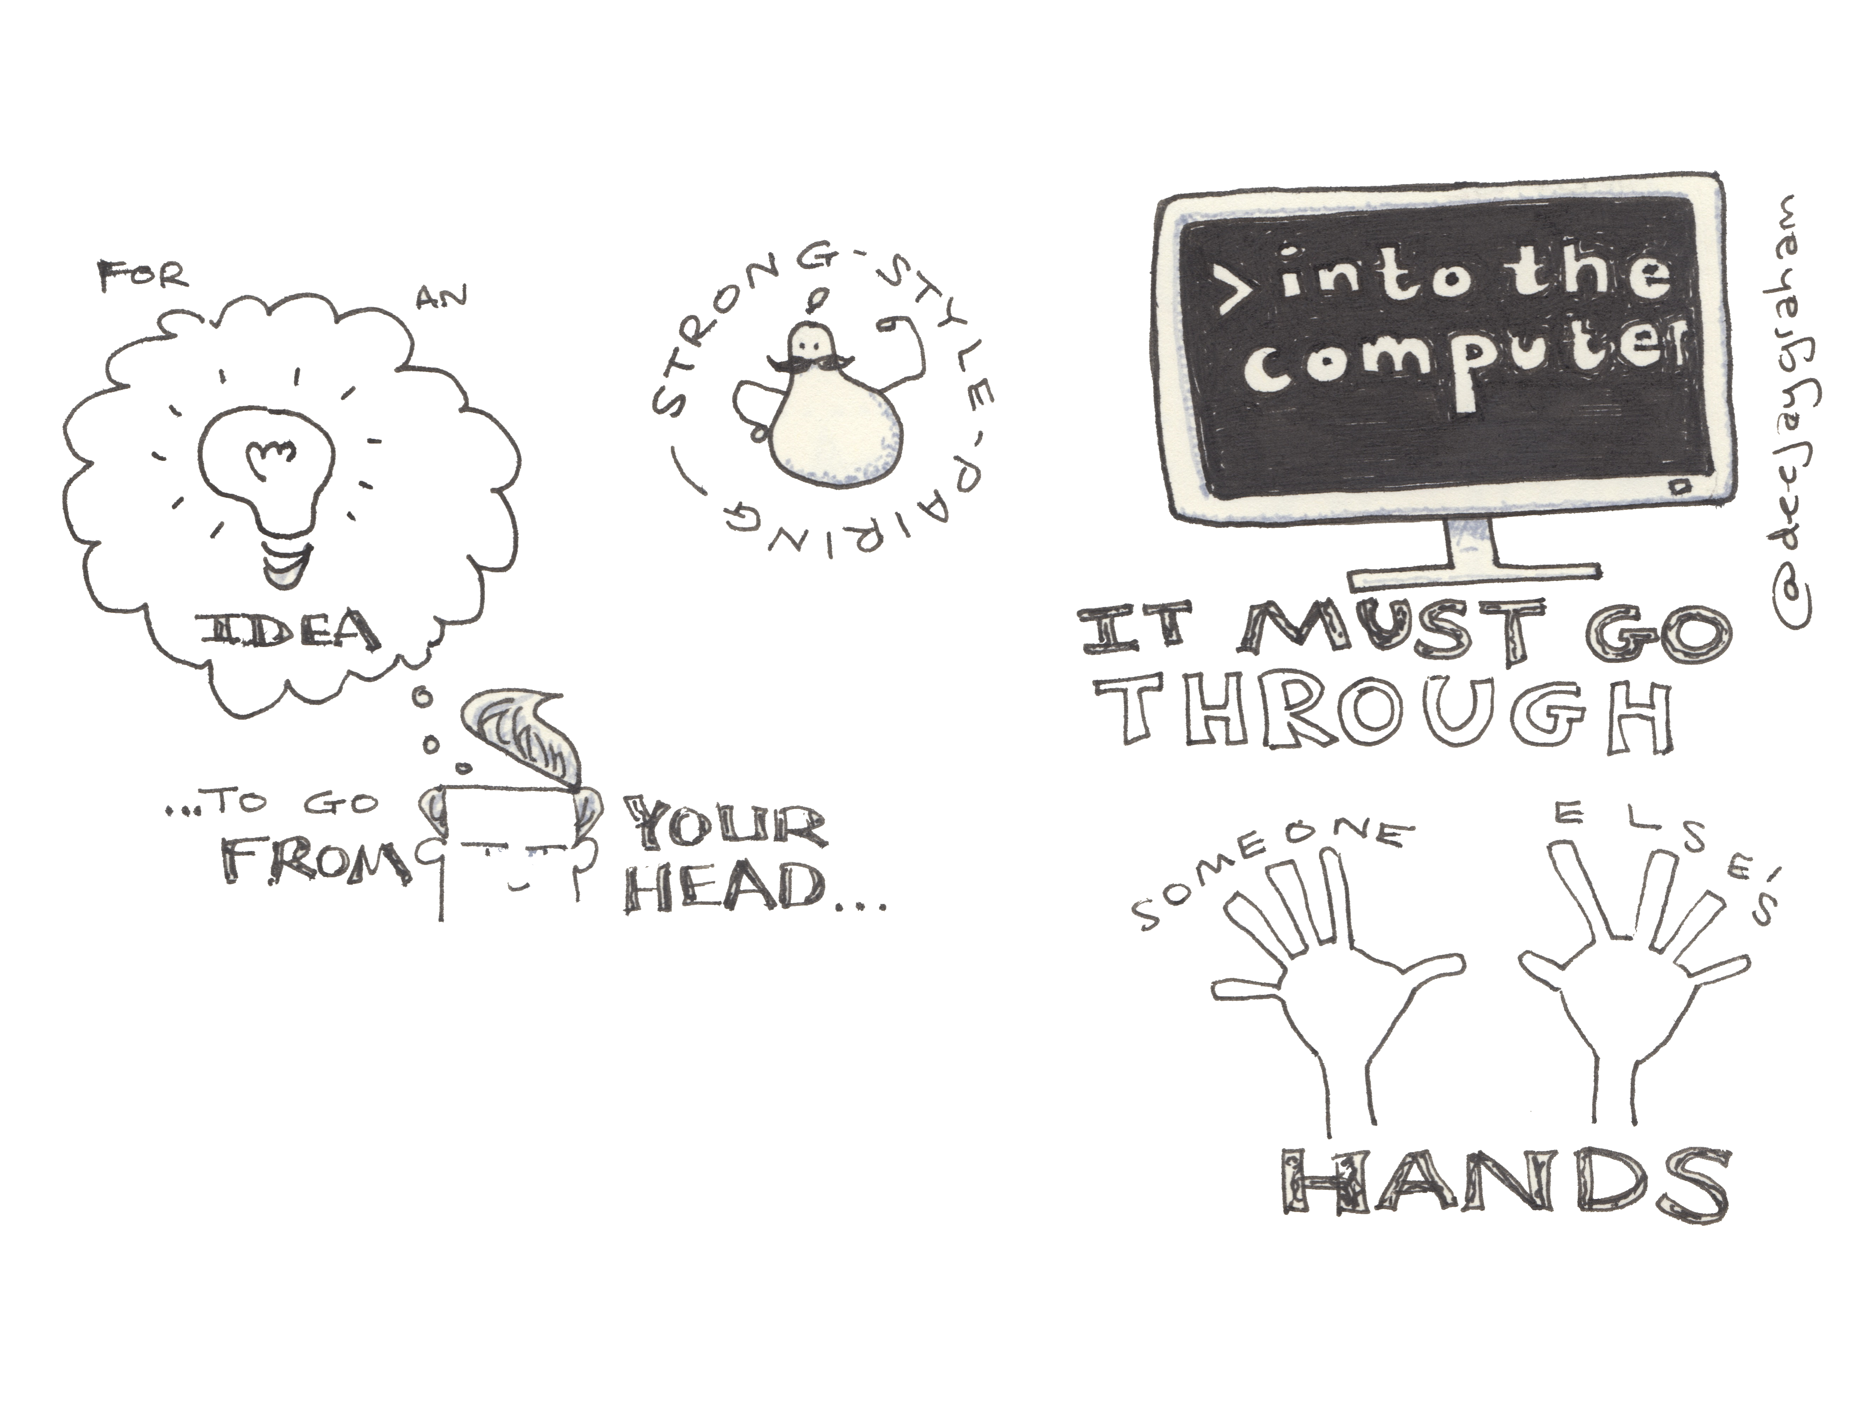
Notes:
can be difficult to do,
first you will want to grab keyboard
sit on your hands and try to talk instead
code you produce is better quality.

Slide 81
“For an idea to go from
your head into the computer,
it MUST go through
someone else's hands.”
–Llewellyn Falco

Slide 82
Finding the right level
Abstractions
Language syntax
Files, line numbers
Key presses
Notes:
Is the Typist typing?
Do they look confused?
Talk at the right level for each person:
osmosis, rise up levels

Slide 83
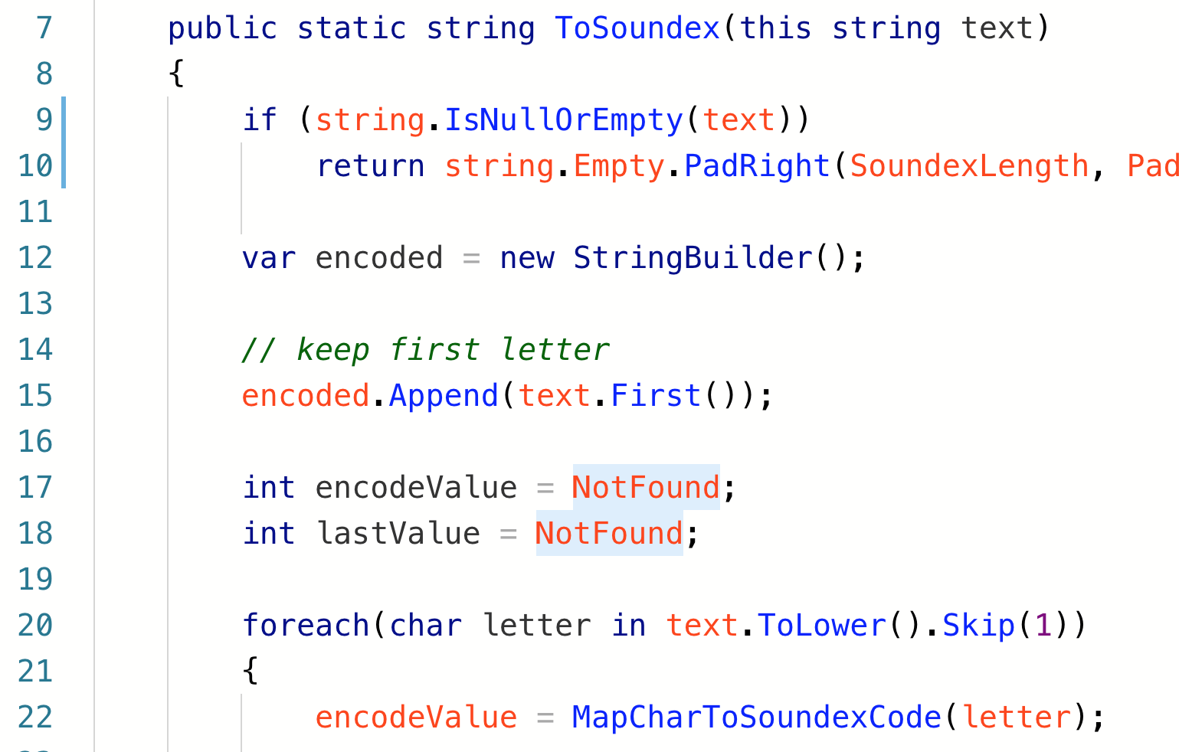
Notes:
Random code - Making a change via a .net dev will be different to non-dev.
Change line 15, split into two?
Could say something like - split that line into two
HACK - Or cut part in brackets insert into 14.5

Slide 84
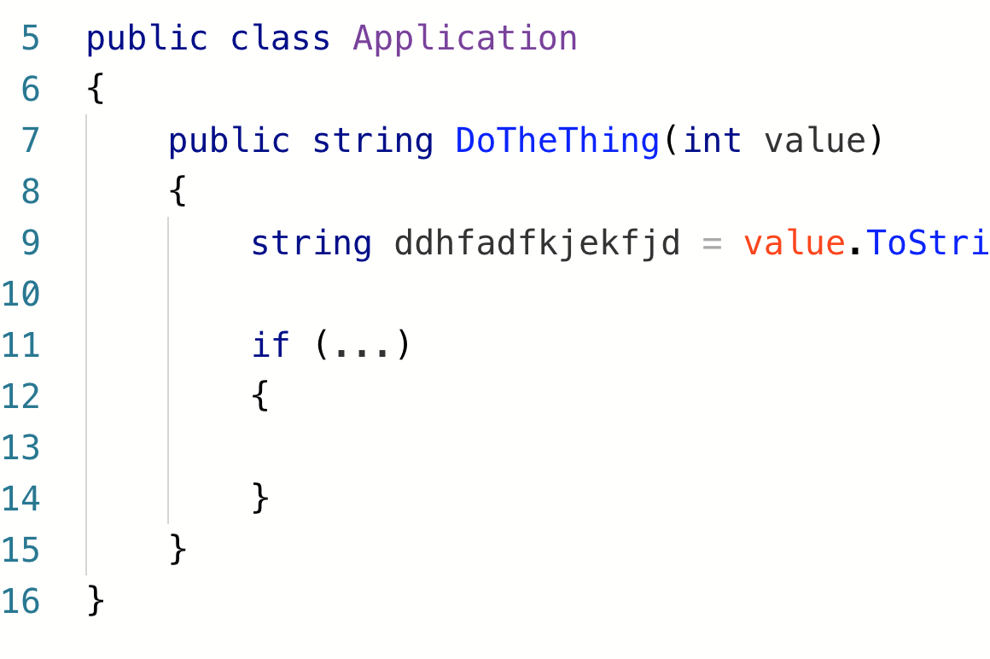
Notes:
Frequently a Mob will get stuck on naming. Give a variable an obviously wrong name to begin with until it gets beyond annoying, then agree on how it is being used. Better names.

Slide 85
When?
Notes:
Don’t give experts the keyboard at all

Slide 86
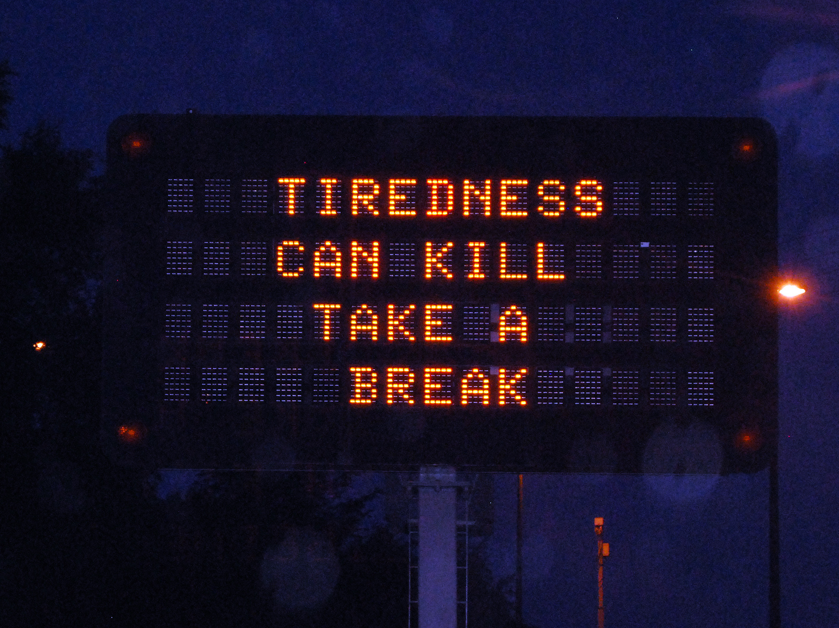

Slide 87
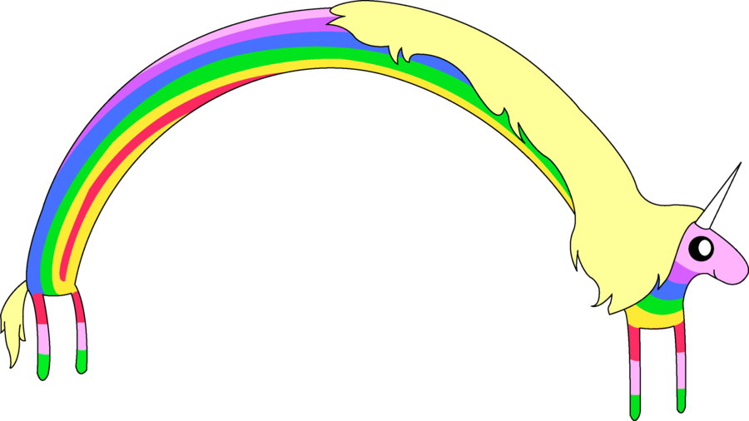
FUN!
Notes:
adventure time unicorns

Slide 88
When to…
Always :)
New work
Hard problems
Across Handoffs
Notes:
Code Merges?
Group learning
morning only, all day - cucumber team
adhocracy

Slide 89
When not to…
Sys admin and Dev Ops (pair instead)
Long running tasks
Small problems
J F D I
Notes:
headphones and crunch

Slide 90
Notes:
Example at a local meetup with Amitai Schleier last year. Awkward, lots of .net devs working in python, in an unfamiliar editor in front of their peers!!!
I had to be first volunteer, then I called on a friend then room kind of relaxed because no one could type with 30 people watching them. You will make mistakes - everyone does.

Slide 91
Disagreements
& Uncertainty
Notes:
Often have times when way is not clear

Slide 92
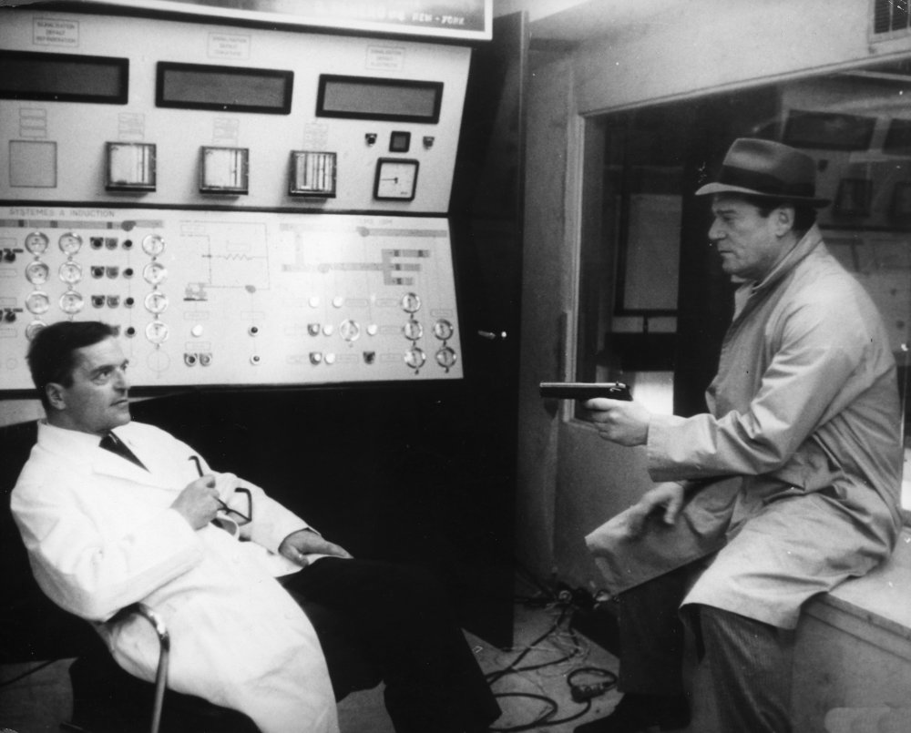
Notes:
Here’s one way to solve it.
time box - rollback
split up to poc spike
split up to research set period
come back together and present
decide as a group way forward

Slide 93


Slide 94


Slide 95
Inspect
& Adapt
Notes:
mentioned retrospectives earlier

Slide 96
Informal Huddle
As often as you need to:
How are we doing?
What is easy?
What is hard?
Notes:
at the end of the session, end of the day?
Opportunity to reflect. Don’t forget, constant communication can mean fewer status and synching meetings.

Slide 97
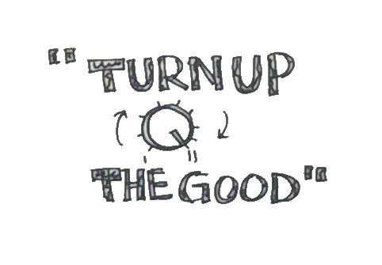

Slide 98
Turn up
the Good!
Notes:
concentrate on improvements,
don’t worry so much about what is wrong.

Slide 99
Resources

Slide 100
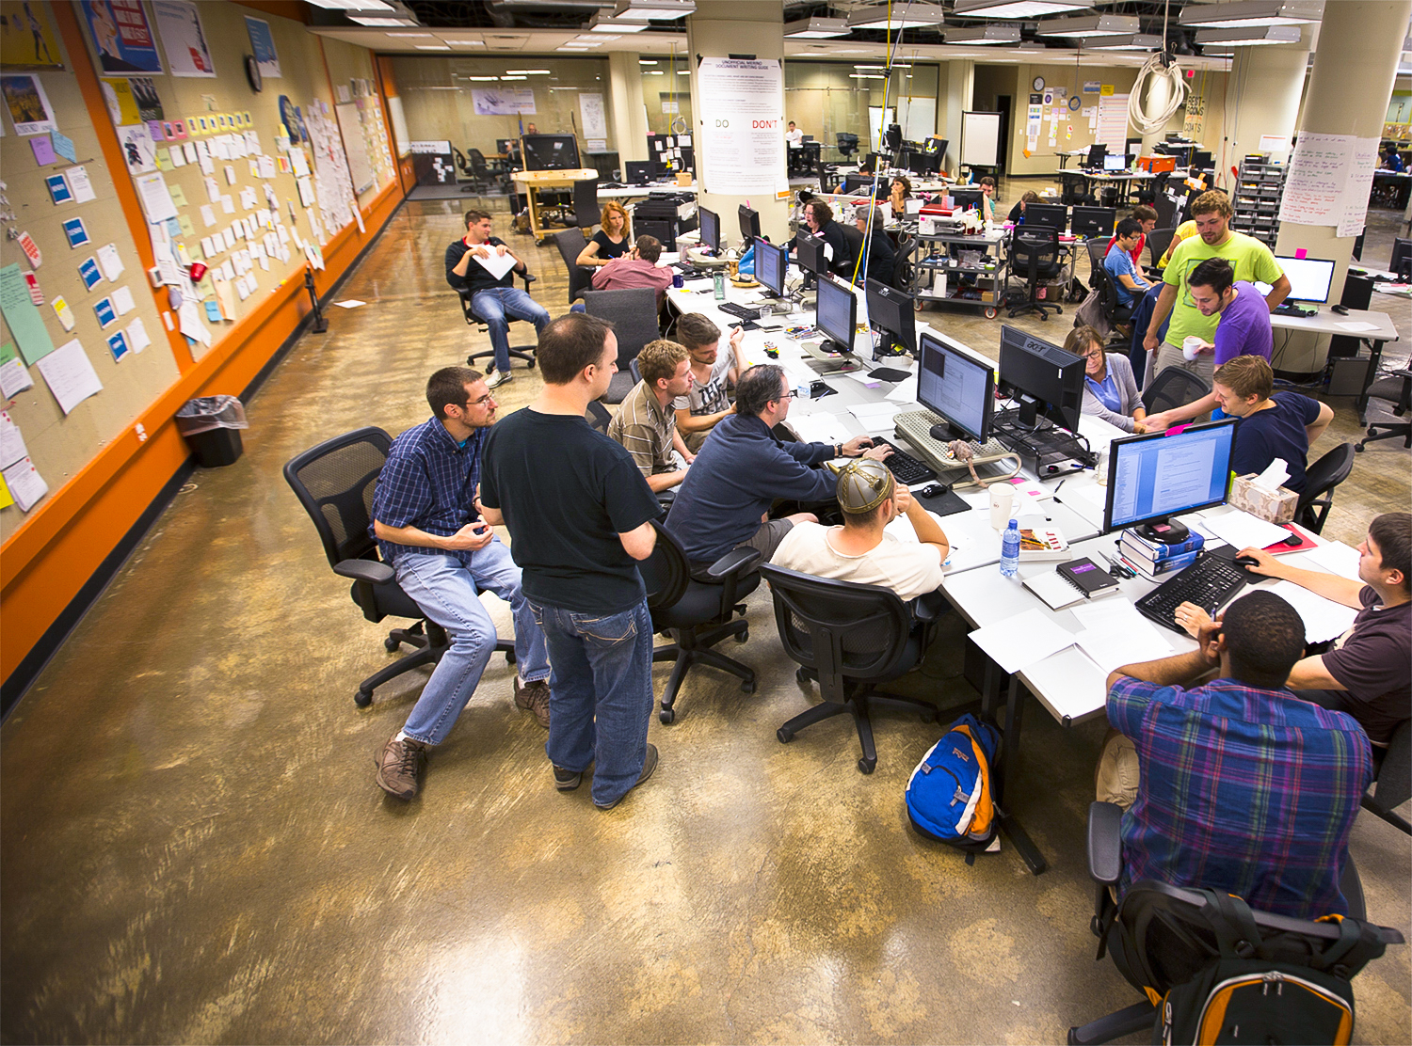
Mob-Positive Teams
Hunter Industries
Industrial Logic
Alaska Airlines
LateRooms.com
pluralsight.com
GDS (gov.uk)
Unruly Media
Blue Fruit
Menlo innovations
…and many more
Notes:
sage not included yet

Slide 101
Mobbing - http://mobprogramming.org
Woody Zuill - https://www.industriallogic.com
Chris Lucian - http://www.chrislucian.com/
mob timer - https://github.com/dillonkearns/mobster
Strong style pairing - https://llewellynfalco.blogspot.co.uk/
Amy Edmondson - https://hbr.org/2013/12/the-three-pillars-of-a-teaming-culture
Notes:
5 minutes

Slide 102
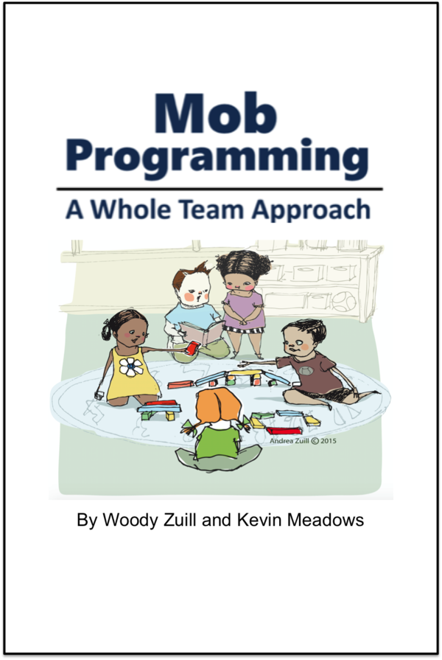
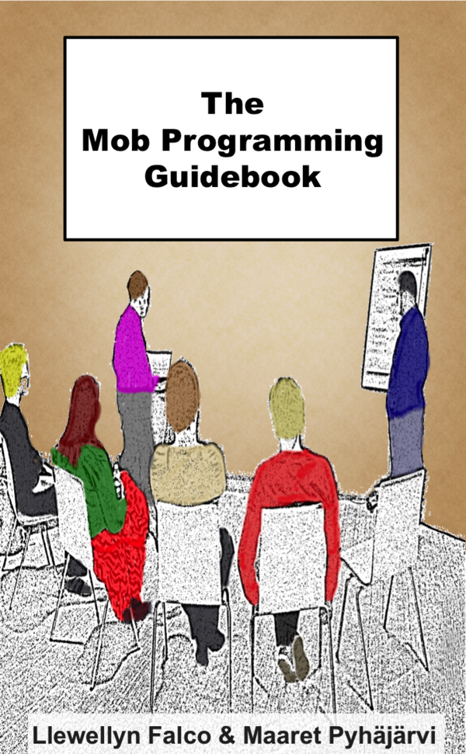
https://leanpub.com/mobprogramming
Notes:
Two different approaches - both worth looking at.

Slide 103
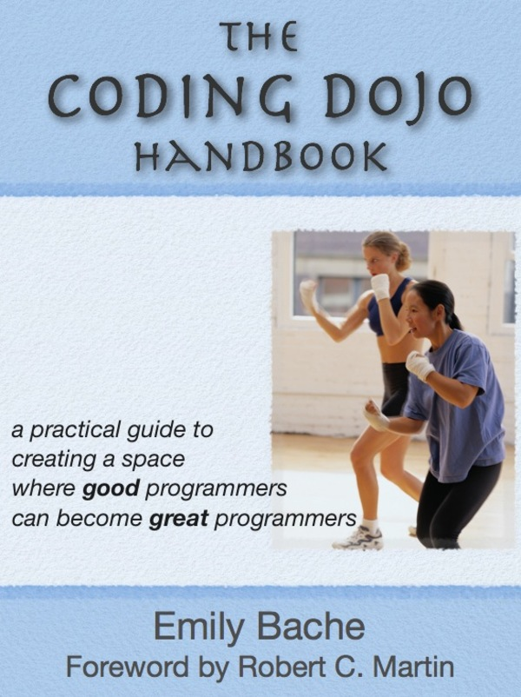
https://leanpub.com/codingdojohandbook
Notes:
Helped me with dojos and she presents several organization techniques similar to MP.

Slide 104
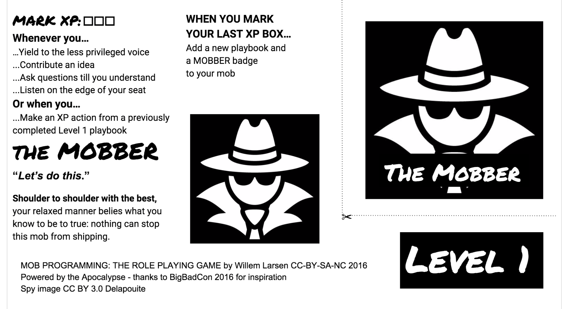
https://github.com/willemlarsen/mobprogrammingrpg
Notes:
Role playing game on github

Slide 105
Problem Solving
Bray, R. M., Kerr, N. L., & Atkin, R. S. (1978). "Effects of group size, problem difficulty, and sex on group performance and member reactions." Journal of Personality and Social Psychology, 36, 1224-1240.
Notes:
Individual or XP pairs can solve problem up to intelligence of brightest person.
Mobs can solve problems exceeding brightest person.

Slide 106
What can you take away?

Slide 107
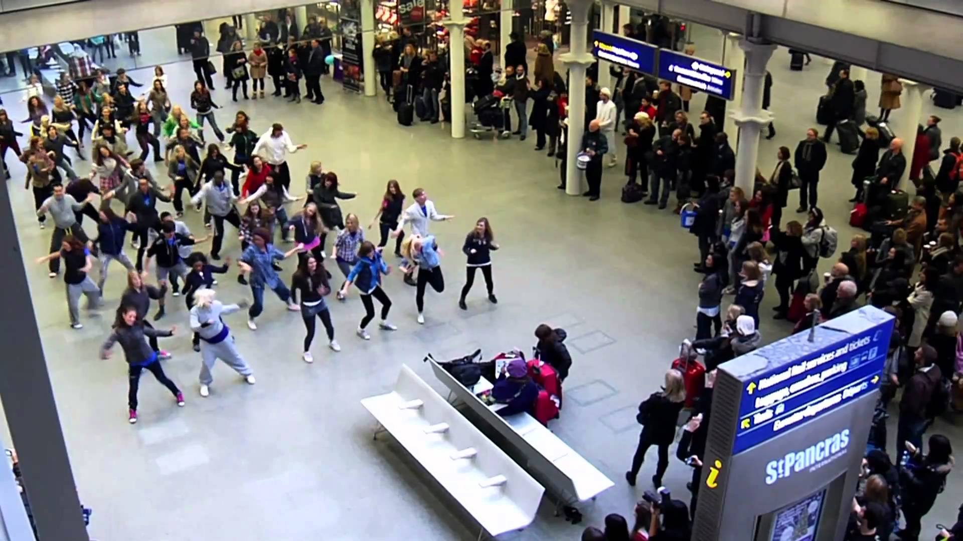
Experiment and discover what works for you
Expect to evolve
Culture change is hard
Flash Mob?
If nothing else…

Slide 108
<strong>
</strong>
Notes:
Strong Style Pair programming is the smallest thing that you can sneak into your development culture without anyone noticing, for the biggest benefit.

Slide 109
What we noticed…
Code readability
Reduced Code Ambiguity
Improved Understanding
Testing was easier
Hard to hide bad code or tests
Reduced Truck Numbers
Notes:
Solo is faster but not for full lifecycle - incease quality

Slide 110
What we noticed…
Solo is faster (but not for full lifecycle)
Quality is better
“It’s our code”
Completed tasks
No standups necessary

Slide 111
What we noticed…
Loud
Communication is hard
Productivity slow at start
Scary coding and talking in front of others
Slow performance is obvious
Text Editor Wars

Slide 112
Notes:
I’ll stop blathering now and stop for questions.

Slide 113

Notes:
feedback forms or feedback in person or on twitter. I find it very valuable so please share if you feel so moved.

Slide 114
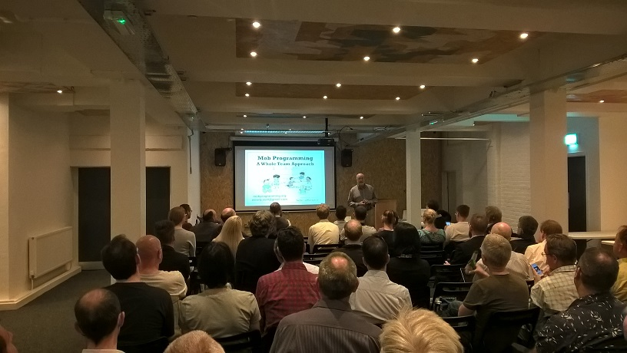
Notes:
#Humblebrag
Woody at CN in 2016
Back in July 2018

Slide 115
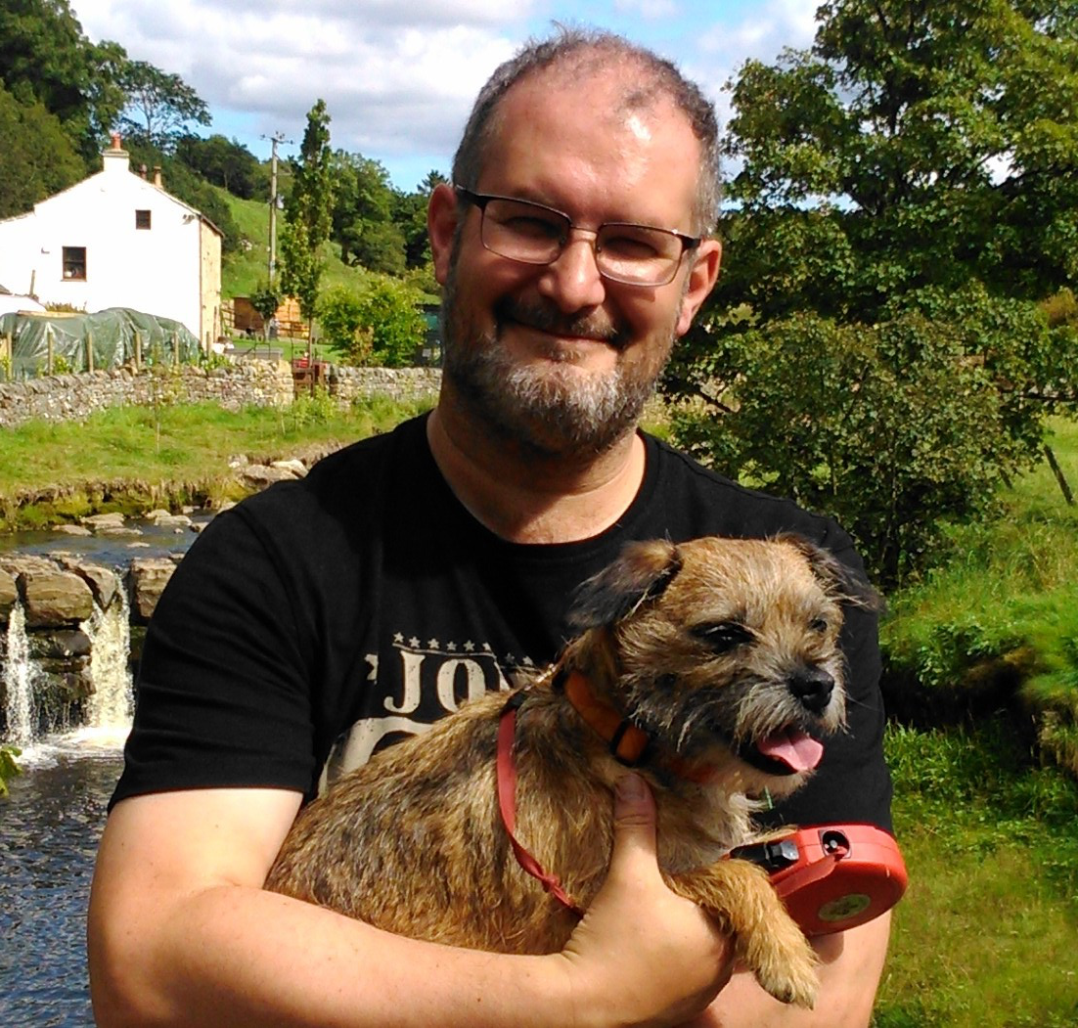
@deejaygraham
deejaygraham@icloud.com
deejaygraham.github.io
Notes:
Tweet slides at end.

Slide 116
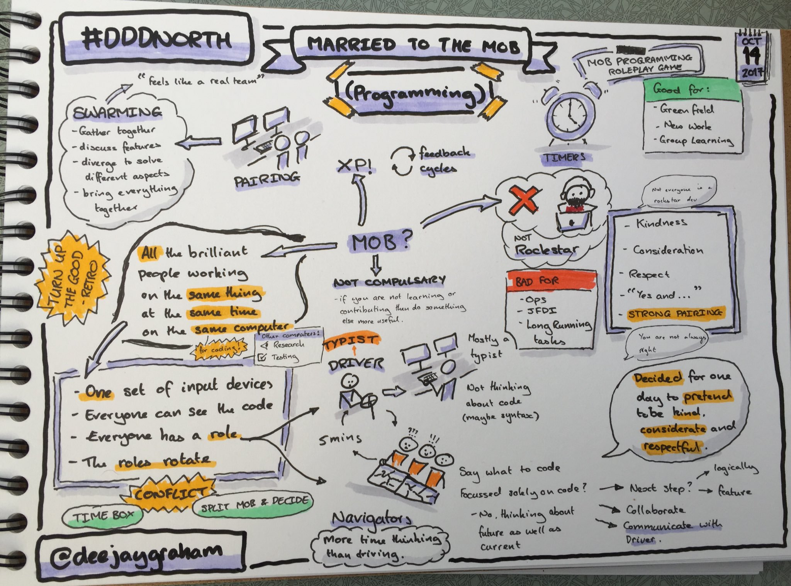

Slide 117


